Slide 1
Introduction
to
Microsoft PowerPoint 2010

Slide 2
Working with Multimedia PowerPoint

Slide 3
Objectives Overview
How to add Pictures to a slide
How to edit pictures
How to format pictures
How to insert a screen shot
How to add shapes to slide
How to edit shapes
How to format shapes
How to add text to shapes
How to arrange shapes/images
How to group/ungroup objects

Slide 4
Objectives Overview
How to add audio & video
How to add & format Tables
How to add & format charts
How to add & format SmartArt
How to add & preview Animations
How to add & preview transitions

Slide 5
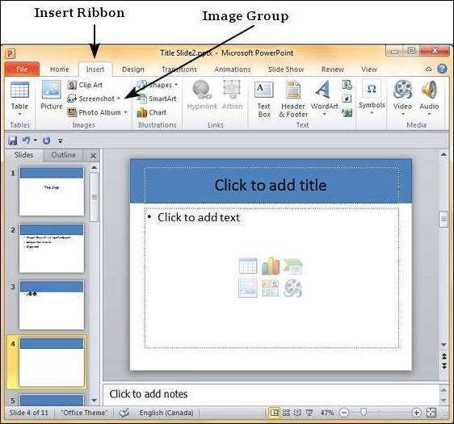
Add Pictures to Slide in PowerPoint 2010
Step 1
Go to the Images group in the Insert ribbon.

Slide 6
Add Pictures to Slide in PowerPoint 2010
Step 2
Click on Picture to open the Insert Picture dialog and add a picture to the slide.
Step 3
In this dialog, you have three sections: to the left corner, you have folders that can be browsed, the section in the centre shows the subfolders and files in the selected folder and to the right, you can have a preview of the selected image.

Slide 7
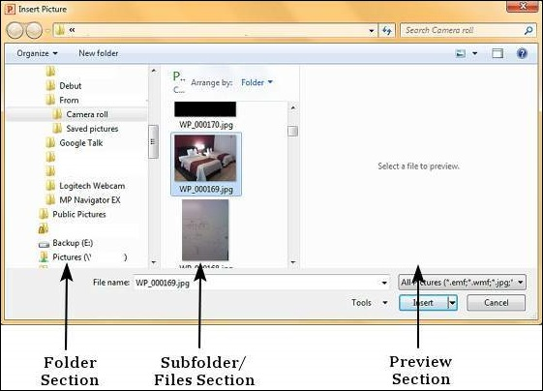
Add Pictures to Slide in PowerPoint 2010

Slide 8
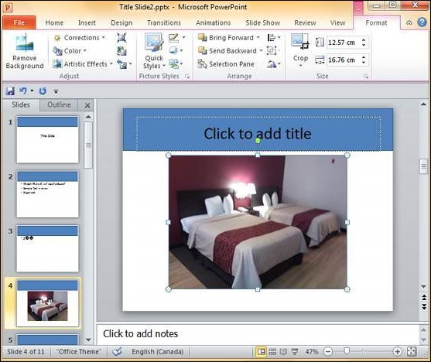
Add Pictures to Slide in PowerPoint 2010
Step 4
Select the image you want and click Open to add the picture to the slide.

Slide 9
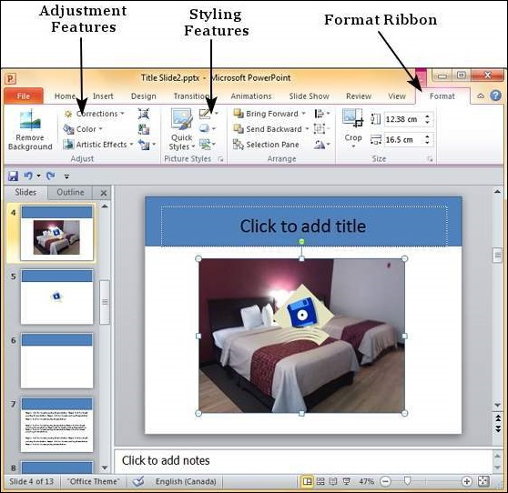
Editing Added Pictures in PowerPoint 2010
The editing features are grouped under the Adjust and Picture Styles section in the Format ribbon.

Slide 10
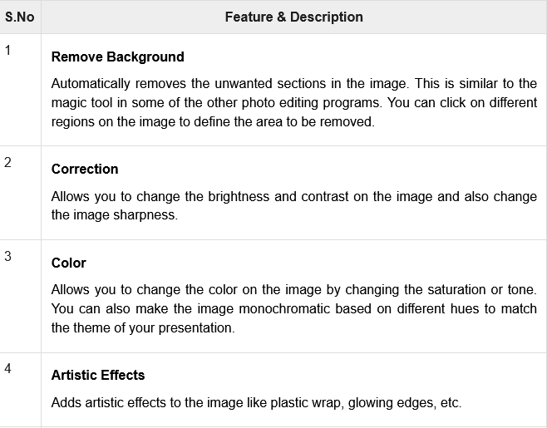
Editing Added Pictures in PowerPoint 2010

Slide 11
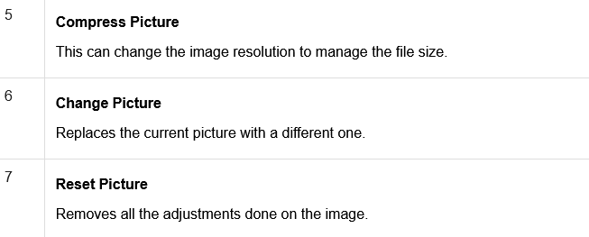
Editing Added Pictures in PowerPoint 2010

Slide 12
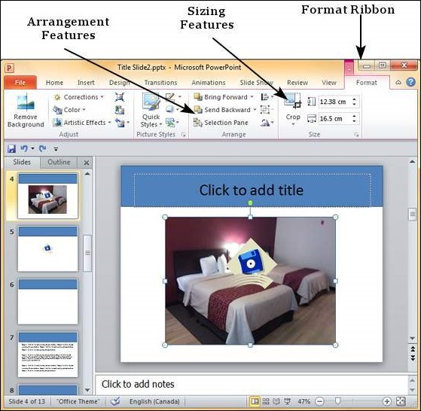
Format Added Pictures in PowerPoint 2010
The formatting features are grouped under the Arrange and Size section in the Format ribbon.

Slide 13
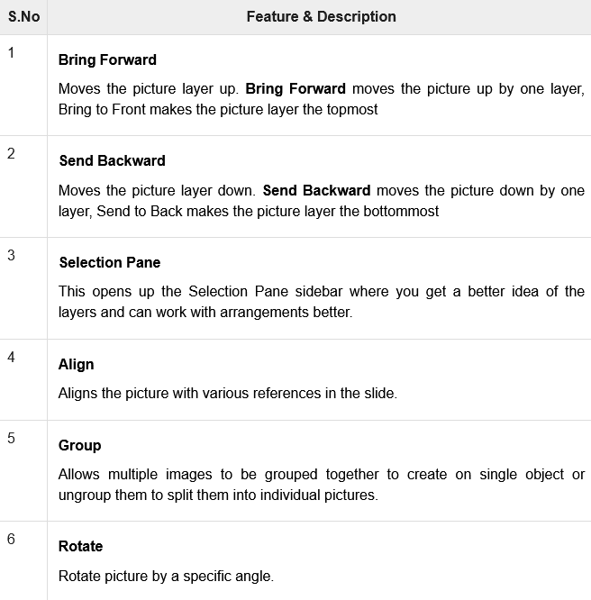
Picture Arrangement Features

Slide 14
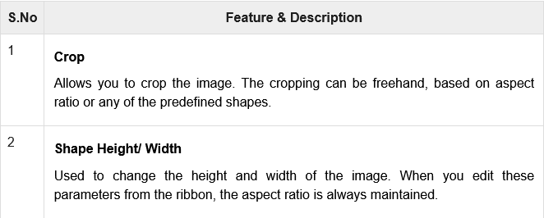
Picture Sizing Features

Slide 15
Inserting a Screenshot in PowerPoint 2010
Step 1
Go to the Images group in the Insert Ribbon.

Slide 16
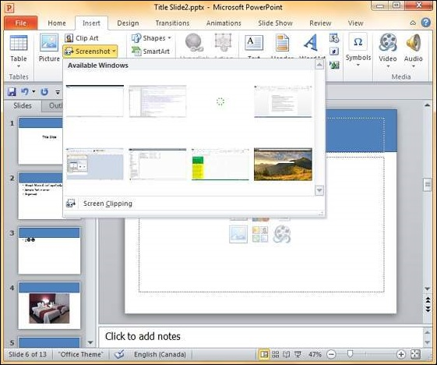
Inserting a Screenshot in PowerPoint 2010
Step 2
Click on the Screenshot dropdown to look at full screen snaps of all the applications running on your computer’s desktop.

Slide 17
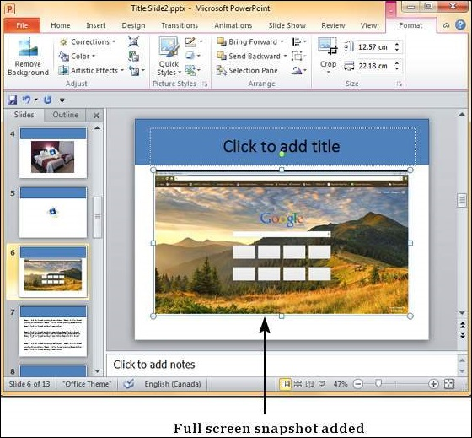
Inserting a Screenshot in PowerPoint 2010
Step 3
Select one of the screenshots to add it directly on to your presentation.

Slide 18

Inserting a Screenshot in PowerPoint 2010
Step 4
If you do not want the entire screen and just a portion of it, you can use the Screen Clipping option.

Slide 19
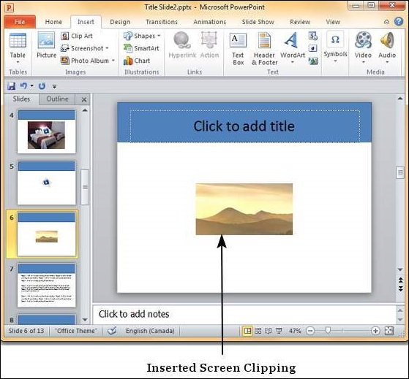
Inserting a Screenshot in PowerPoint 2010
Step 4
The Screen Clipping option will automatically move the focus to the program immediately below PowerPoint.
So while using this option, ensure that you have the right screen behind the PowerPoint program.

Slide 20
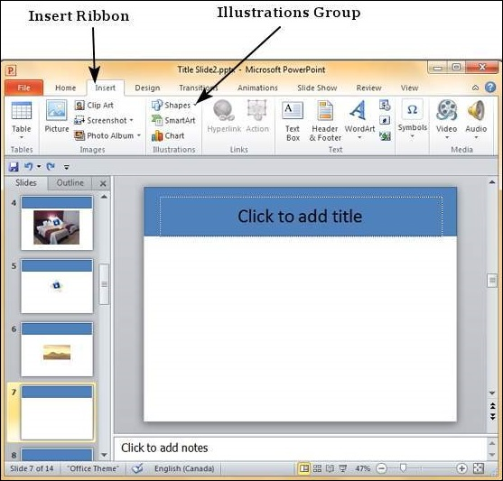
Adding Shapes to Slide in PowerPoint 2010
Step 1
Go to the Illustrations group under the Insert Tab.

Slide 21
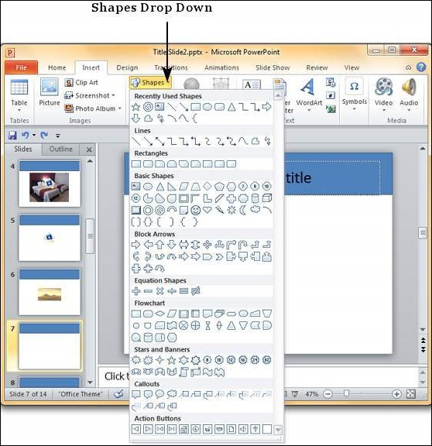
Adding Shapes to Slide in PowerPoint 2010
Step 2
Click on the Shapes dropdown to view the available shapes.

Slide 22
Adding Shapes to Slide in PowerPoint 2010
Step 3
Select the shape you want to insert. This will change the cursor to a + sign.
Step 4
Click and drag on the slide to create the shape.
As you drag, the shape will show up on the slide.
Continue to drag and adjust the size and the symmetry of the shape.

Slide 23
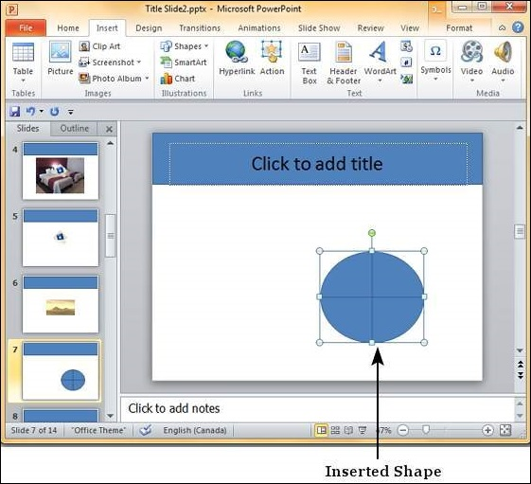
Adding Shapes to Slide in PowerPoint 2010

Slide 24
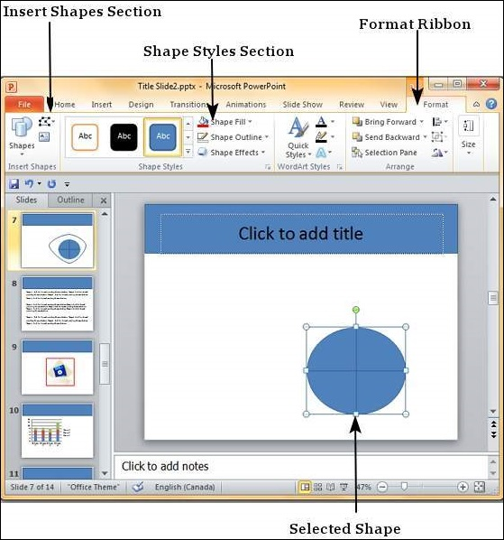
Editing Added Shapes in PowerPoint 2010

Slide 25
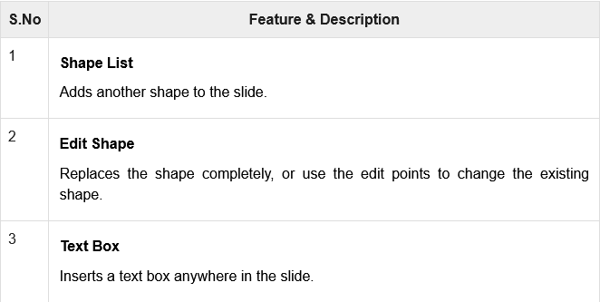
Insert Shape Features

Slide 26
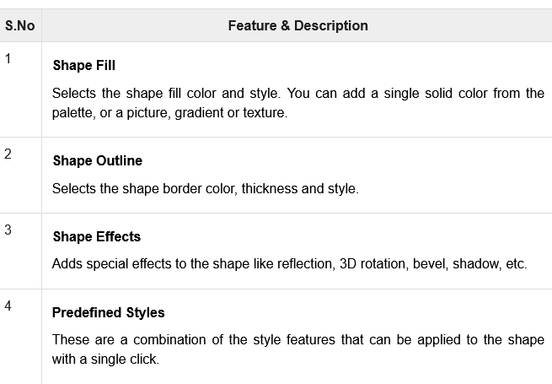
Shape Styles Features

Slide 27
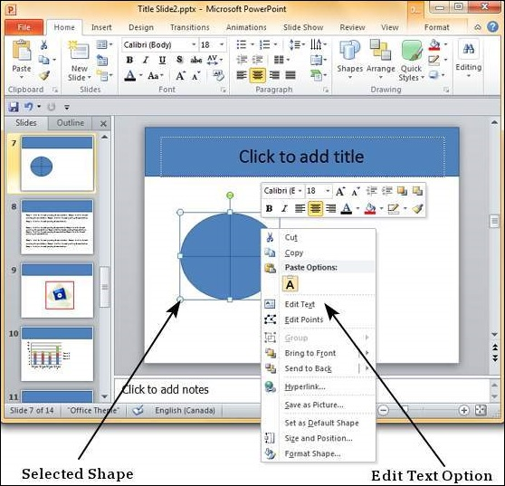
Adding Text to Shapes in PowerPoint 2010
Step 1
Right-click on the shape to which you want to add the text and select the Edit Text option.

Slide 28
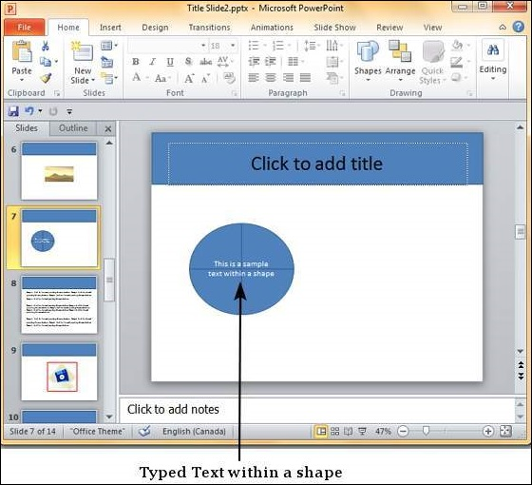
Adding Text to Shapes in PowerPoint 2010
Step 2
Start typing the text into the shape. Once you are done, click the cursor anywhere outside the shape.

Slide 29
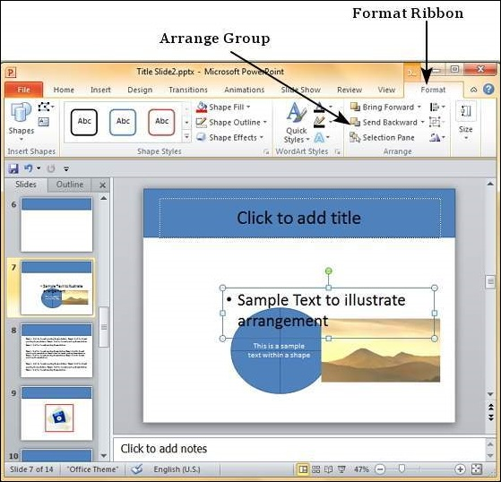
Arrange Shapes/Images in PowerPoint 2010
Step 1
Select one of the contents and go the Arrange group under the Format ribbon.

Slide 30
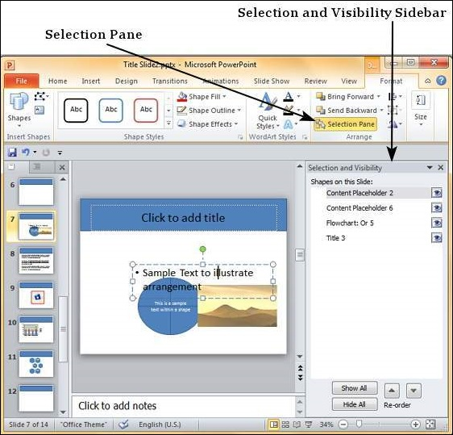
Arrange Shapes/Images in PowerPoint 2010
Step 2
Click on the Selection Pane to open the Selection and Visibility sidebar.

Slide 31
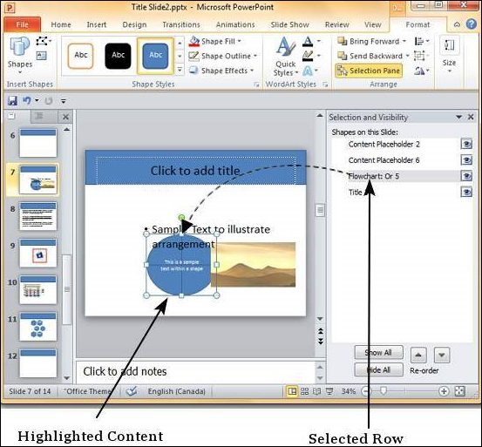
Arrange Shapes/Images in PowerPoint 2010
Step 3
Select one of the rows in the sidebar to highlight the corresponding content in the slide.

Slide 32
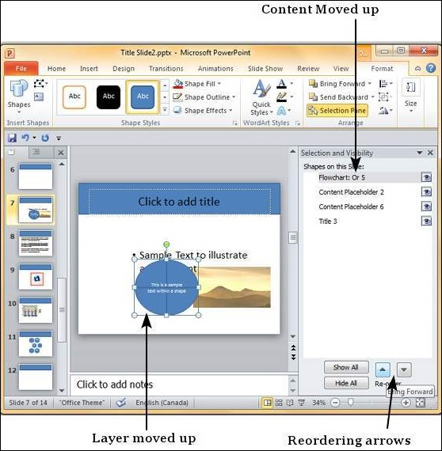
Arrange Shapes/Images in PowerPoint 2010
Step 4
Use the reordering arrows in the sidebar to move the content layer up or down.

Slide 33
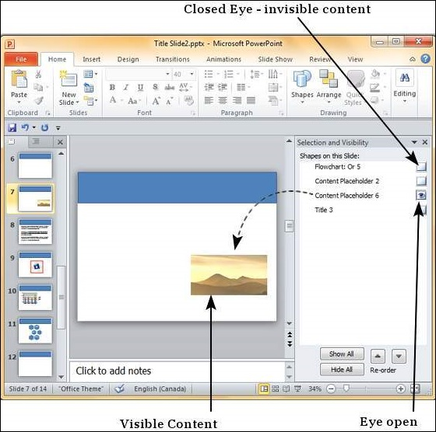
Arrange Shapes/Images in PowerPoint 2010
Step 5
Click on the eye next to each content in the sidebar to toggle its visibility on the slide.

Slide 34
Arrange Shapes/Images in PowerPoint 2010
Instead of using the Selection Pane option, you can also right-click on the content to move it up or down.
When you right-click, besides moving the layers by one step at a time using Bring Forward or Send Backward,
you can also move the content directly to the top or bottom using Bring to Front or Send to Back respectively.

Slide 35
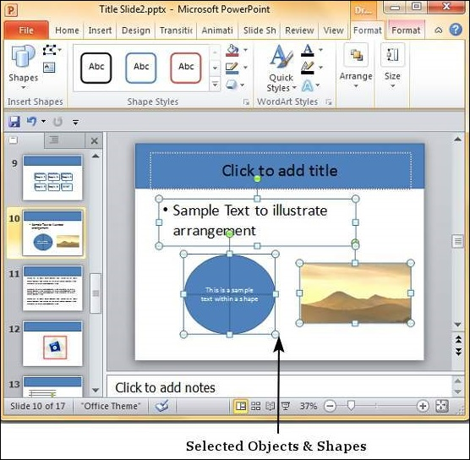
Group/Ungroup Objects in PowerPoint 2010
Step 1
Select a set of shapes or objects together. To select the objects, press the Ctrl key and select each object individually.

Slide 36
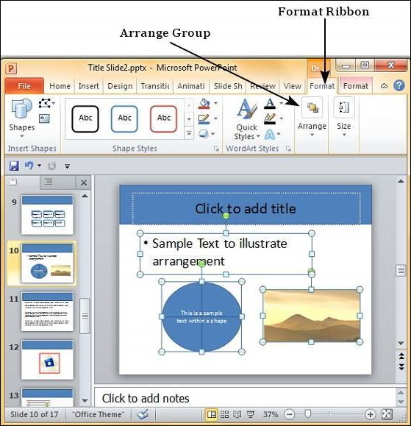
Group/Ungroup Objects in PowerPoint 2010
Step 2
Go to the Arrange Group under the Format ribbon.

Slide 37
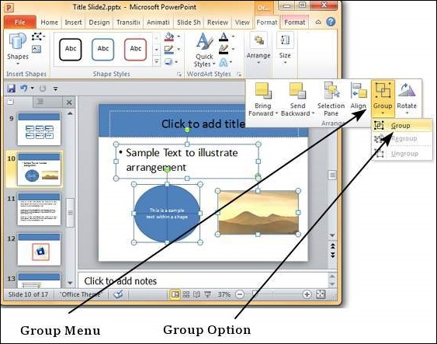
Group/Ungroup Objects in PowerPoint 2010
Step 3
Click on Group under the Group menu item - this will group the objects and shapes into a single object.

Slide 38
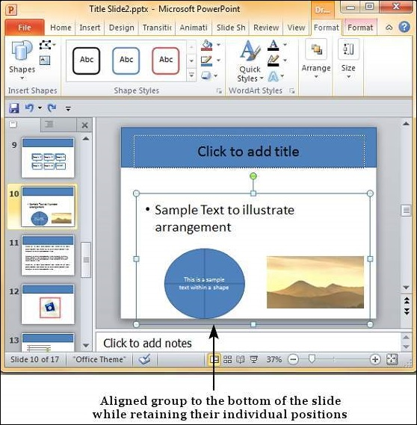
Group/Ungroup Objects in PowerPoint 2010
Step 4
Apply the common changes you want to make to these objects.

Slide 39
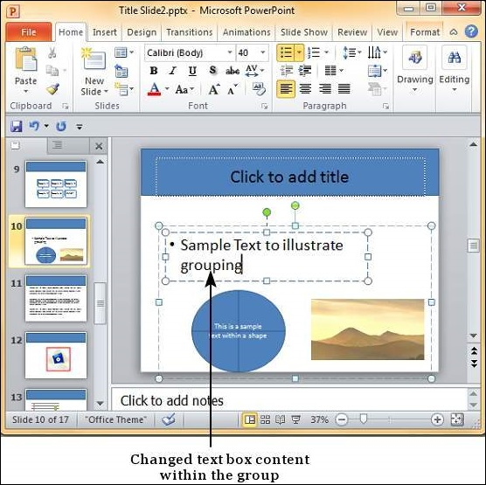
Group/Ungroup Objects in PowerPoint 2010
Step 5
Even though the objects are grouped, you can still edit them individually if need be.

Slide 40
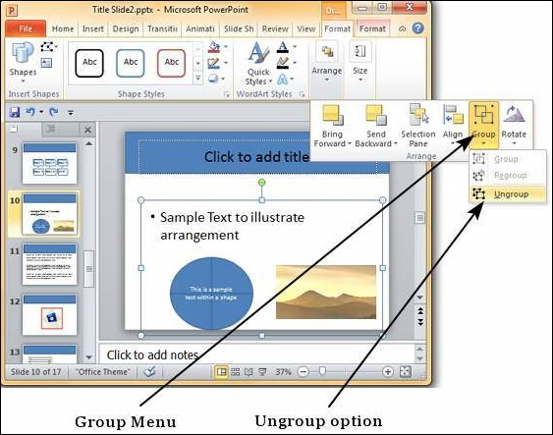
Group/Ungroup Objects in PowerPoint 2010
Step 6
If you want to edit the shapes or objects individually, go back to the Group menu item and select Ungroup.

Slide 41
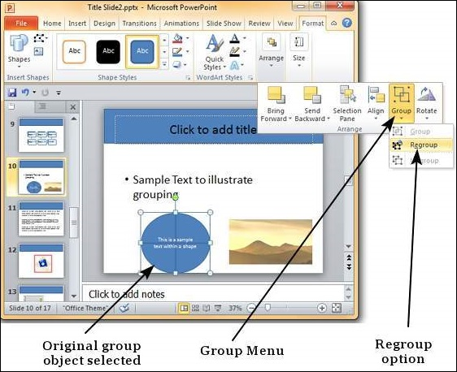
Group/Ungroup Objects in PowerPoint 2010
Step 7
After making changes, if you want to regroup the objects as per original grouping, you select one of the objects and use the Regroup option under the Group menu.

Slide 42
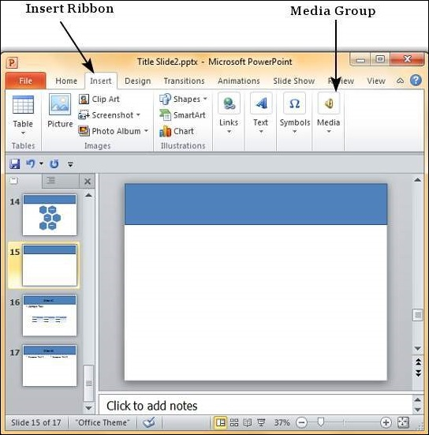
Adding Audio & Video in PowerPoint 2010
Step 1
Go to the Media group under the Insert ribbon.

Slide 43
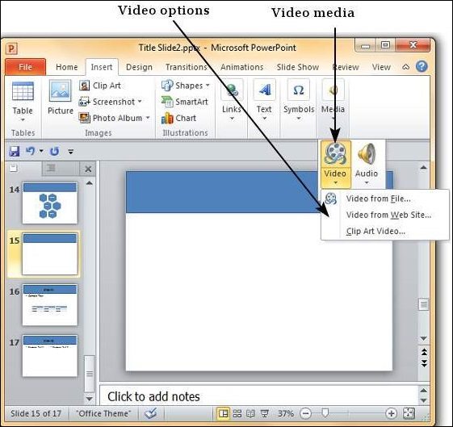
Adding Audio & Video in PowerPoint 2010
Step 2
To insert video file select Video as media type and Video from File to insert a video from your computer or hard drive.

Slide 44
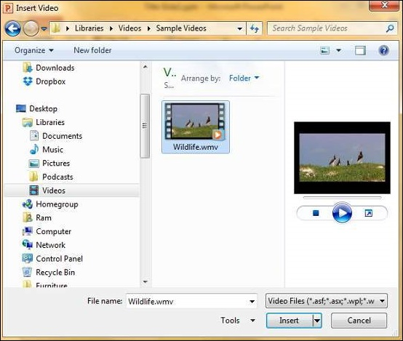
Adding Audio & Video in PowerPoint 2010
Step 3
In the Insert Video dialog, browse for a video file and click Insert.

Slide 45
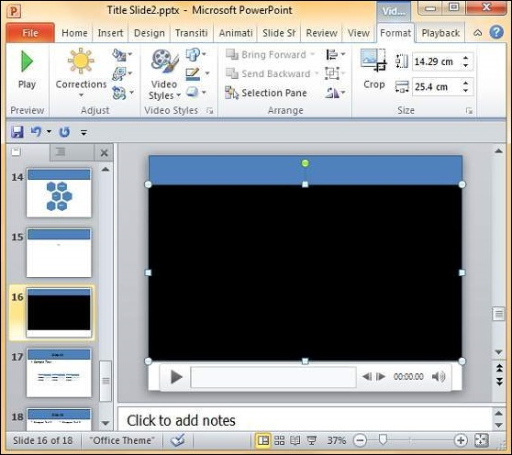
Adding Audio & Video in PowerPoint 2010
Step 4
You will now see that a Video file is added to the slide.

Slide 46
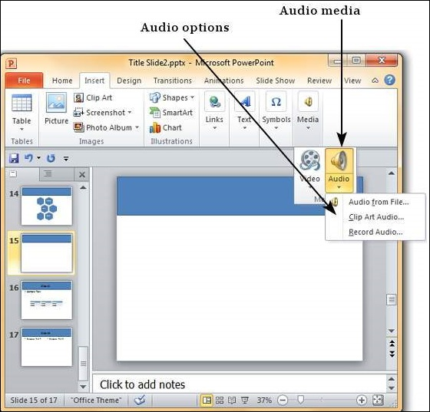
Adding Audio & Video in PowerPoint 2010
Step 5
To insert audio file select Audio as media type and Audio from File to insert an Audio from your computer or hard drive.

Slide 47
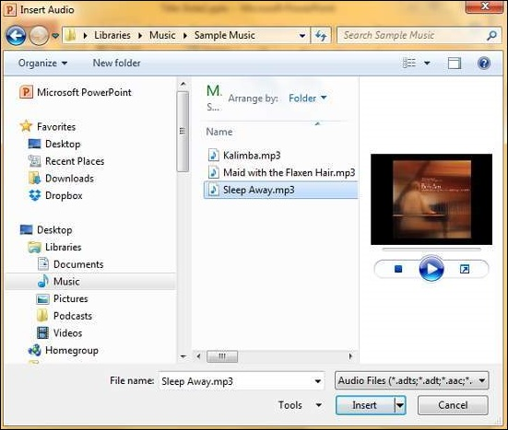
Adding Audio & Video in PowerPoint 2010
Step 6
In the Insert Audio dialog, browse for an audio file and click Insert.

Slide 48
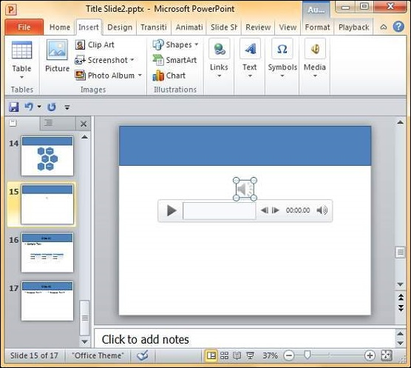
Adding Audio & Video in PowerPoint 2010
Step 7
You will now see that an Audio file is added to the slide.

Slide 49
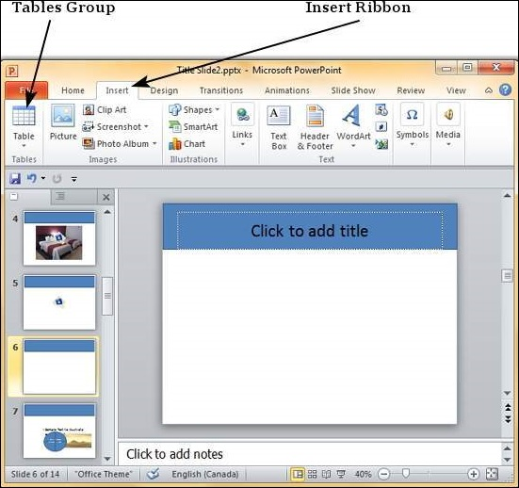
Add & Format Tables PowerPoint 2010
Step 1
Go to the Tables group under the Insert ribbon.

Slide 50
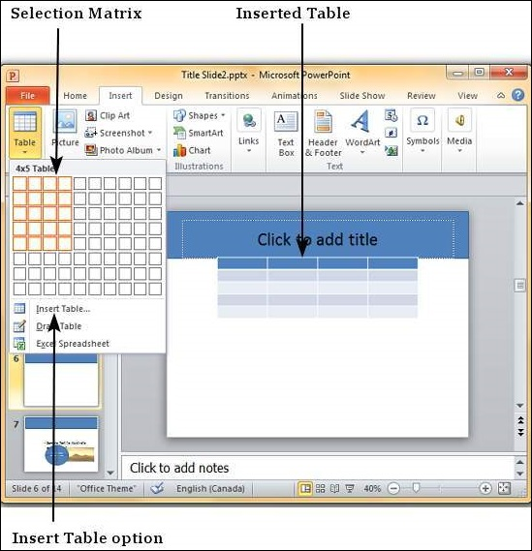
Add & Format Tables PowerPoint 2010
Step 2
Click on the dropdown and select your table dimension from the matrix.

Slide 51
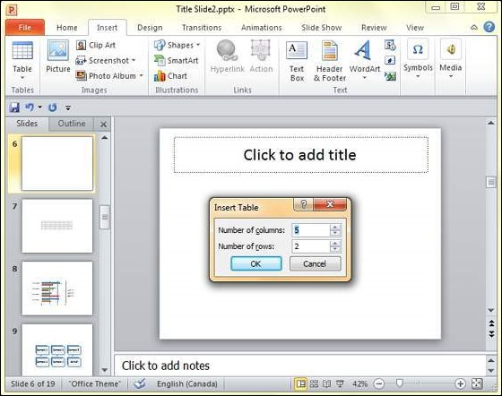
Add & Format Tables PowerPoint 2010
Step 3
If you require more than 10 columns or 8 rows click on "Insert Table" to open the Insert Table dialog where you can specify the column and row count..

Slide 52
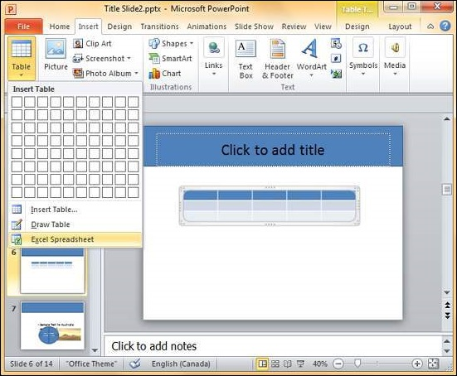
Add & Format Tables PowerPoint 2010
PowerPoint table is a simple table that does not support the mathematical features of an Excel spreadsheet.
If you want to carry out some calculations, you can insert an Excel spreadsheet instead of a regular table.

Slide 53
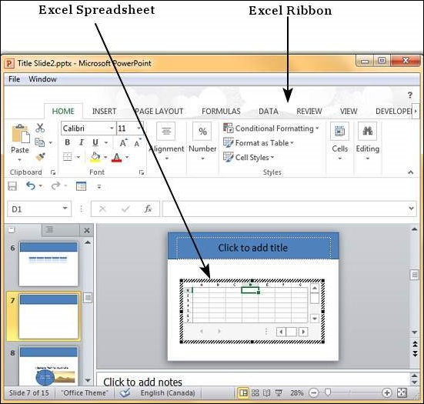
Add & Format Tables PowerPoint 2010
This will insert the spreadsheet in the slide and as long as the spreadsheet is selected, the ribbon at the top will be changed to an Excel ribbon instead of a PowerPoint one.

Slide 54
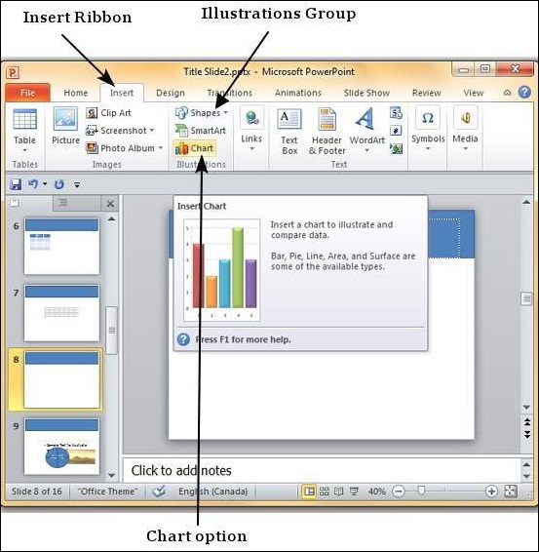
Add & Format Charts in PowerPoint 2010
Step 1
Go to the Illustrations group under the Insert ribbon.

Slide 55
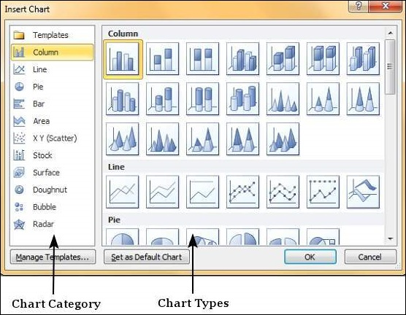
Add & Format Charts in PowerPoint 2010
Step 2
Click on the Chart option to open the Insert Chart dialog. You can choose the chart category and pick individual chart types from the list.

Slide 56
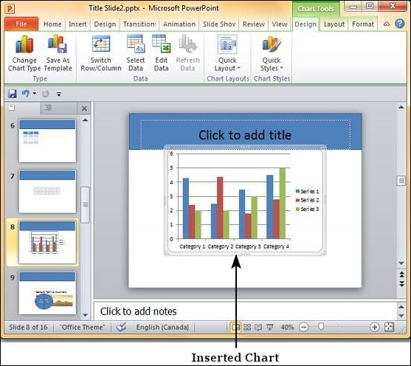
Add & Format Charts in PowerPoint 2010
Step 3
Select the chart type and click OK or double-click on the chart type to insert the chart in the slide.

Slide 57
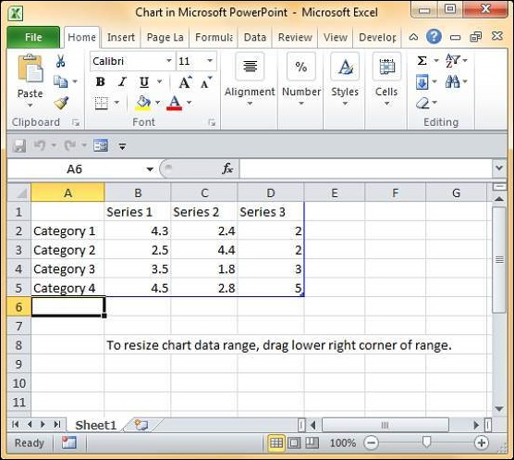
Add & Format Charts in PowerPoint 2010
Step 4
Along with the chart, an Excel spreadsheet is also launched. This spreadsheet is the source for your chart.

Slide 58
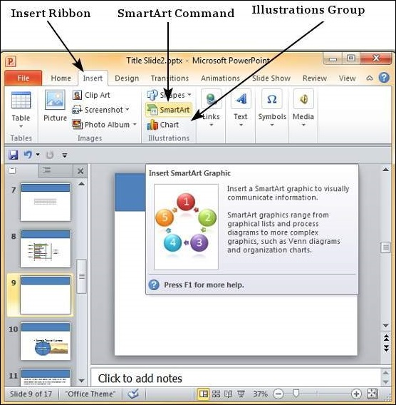
Add & Format SmartArt in PowerPoint 2010
Step 1
Go to the Illustrations group under the Insert ribbon.

Slide 59
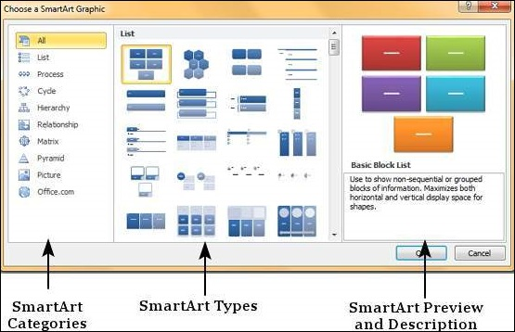
Add & Format SmartArt in PowerPoint 2010
Step 2
Click on the SmartArt command to open the Choose a SmartArt Graphic dialog.

Slide 60
Add & Format SmartArt in PowerPoint 2010
Step 3
Select the SmartArt type and click OK or double-click on the SmartArt type to insert the graphic in the slide..
Step 4
The graphic is inserted in the slide along with a text pane where you can enter/ modify the SmartArt text.

Slide 61

Add & Format SmartArt in PowerPoint 2010

Slide 62

Add & Format SmartArt in PowerPoint 2010
Step 5
Add the necessary details and close the text pane to complete the SmartArt insertion.

Slide 63

Add & Preview Animations PowerPoint 2010
Step 1
Go to the Animation ribbon and click on the Animation Pane to display the animation sidebar.

Slide 64

Add & Preview Animations PowerPoint 2010
Step 2
Select one of the objects in the slide and click on the Add Animation menu option.

Slide 65

Add & Preview Animations PowerPoint 2010
Step 3
Choose from one of the Animation options.
Entrance: will cause the object to appear in the screen.
Emphasis: will cause the object to emphasis without appearing or leaving the screen.
Exit: will cause the object to disappear from the screen.

Slide 66

Add & Preview Animations PowerPoint 2010
Step 4
Once you add the animation for an object, it will show up in the Animation pane.

Slide 67

Add & Preview Animations PowerPoint 2010
Step 5
By default, all the animations are initiated by a click, but you can change this.
To change the trigger, right-click on the animation object on the pane and choose an alternate trigger.

Slide 68
Add & Preview Animations PowerPoint 2010
Step 5
Start On Click will cause the animation to start when you click the mouse.
Start With Previous will cause the animation to begin with the previous animation; if this is the first object, it will begin as soon as you reach the slide during the slide show.
Start After Previous will cause the animation to begin after the previous animation ends.

Slide 69

Add & Preview Animations PowerPoint 2010
Step 6
From the timing section, you can also manipulate the animation timings.
Step 7
To preview the animation settings, just click Play on the animation pane.

Slide 70

Add & Preview Transitions in PowerPoint 2010
Step 1
Select the slide to which you want to apply the transition.
Go to the Transition Scheme under the Transitions ribbon.

Slide 71

Add & Preview Transitions in PowerPoint 2010
Step 2
Select one of the transition schemes from the list available. PowerPoint will instantly show you a preview of the scheme.

Slide 72

Add & Preview Transitions in PowerPoint 2010
Step 4
You can change the effects on the selected transition scheme from the Effect Options menu.

Slide 73

Add & Preview Transitions in PowerPoint 2010
Step 5
You can also modify the transition timing settings from the Timing section.
Step 6
To preview the slide transition, click on Preview.

Slide 74


Slide 75
THANK YOU

